Slide 1
Program
MineOperate Technical Level 1
Deployment Project
Edgar Sepulveda
Global Technical Manager, MineOperate
10/10/2022
Version 1.3

Slide 2

Purpose
This session …
​At the end of this module, you will:

Slide 3
Project Deployment
MineOperate Project team
- Project Manager Project management activities, 25% of her time.
- Project Engineer Technical Leader, OP Pro configuration and setup.
- Hardware Tech Hardware installs, we could assign 1 or 2 hardware techs in a project.
- Trainer OP Pro system training.

Slide 4
Project Deployment
MineOperate Project plan
- Hardware procurement Activities to coordinate hardware delivery.
- Hardware installs Hardware installs schedule
- System configuration OP Pro installation and configuration.
- Training Training schedule.
- Go live Go live day and support.

Slide 5
Project Deployment
MineOperate Project plan
- Kick off meeting Project presentation with customer stakeholders.
- Pre installation Activity to know what kind of brakes are needed.
- Project plan execution
- Go live Go live day and support.
- Sign off Customer agrees project deployment is complete.
- Customer transition to support Meeting with Project Manager and meeting with Account Manager

Slide 6
Project Deployment
Department | Feature | Data
Survey | Mine Projection | Survey points around the mine in WGS84 and local coordinates
Survey | Map Coordinates | Map Bottom Left and Top Right corners local coordinates
Survey | RTK Corrections | IP address, port and RTK corrections type
Operations | Users | Users Profiles
Operations | Users | Users List
Operations | Equipment | Equipment Types
Operations | Equipment | Equipment List
Operations | Operators | Operators List
Operations | Material Movement | Materials List
Operations | Material Movement | Qualities List
Operations | Material Movement | Grades csv file
Operations | Shift change | Operators Qualifications
Operations | Shift change | Crews
Operations | Shift change | Crews Rotation
Operations | Times | Statuses
Operations | Times | Reasons
Operations | Times | Time Categories
Operations | Times | Availability and Utilization formulas
Maintenance | Prestart Check | Prestart checks
Maintenance | Prestart Check | Prestart items
Drill | Drill Patterns | Drill Patterns csv file

Slide 7
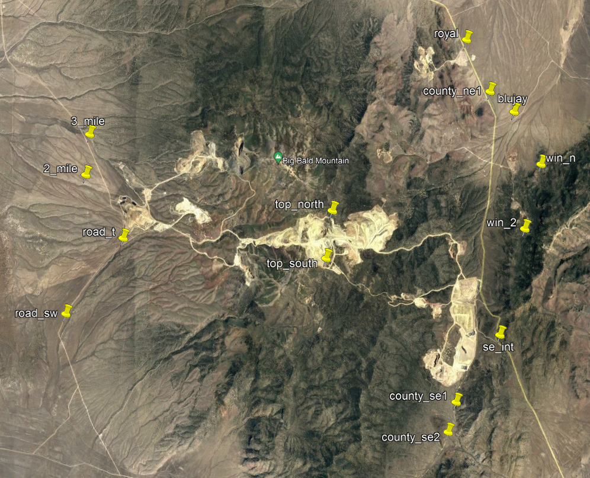
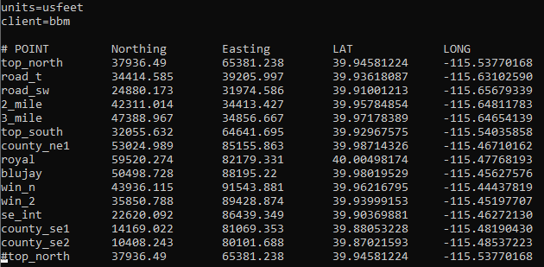
Deployment Project
Survey points around the mine in WGS84 and local coordinates

Slide 8
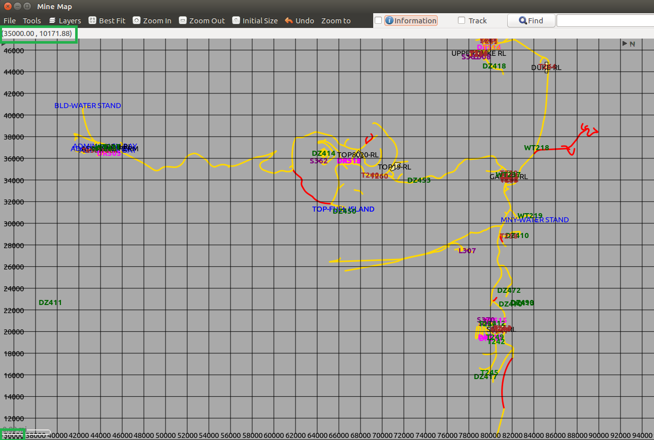
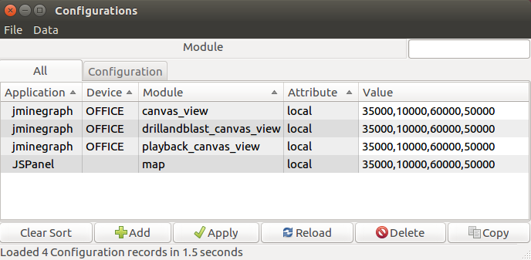
Deployment Project
Map Bottom Left and Top Right corners in local coordinates

Slide 9
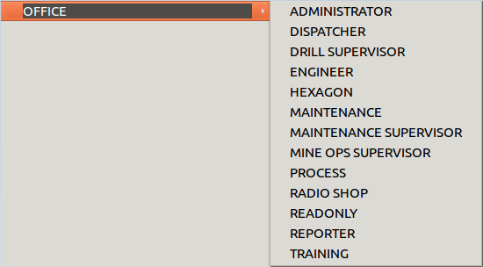
Deployment Project
Users Profiles

Slide 10
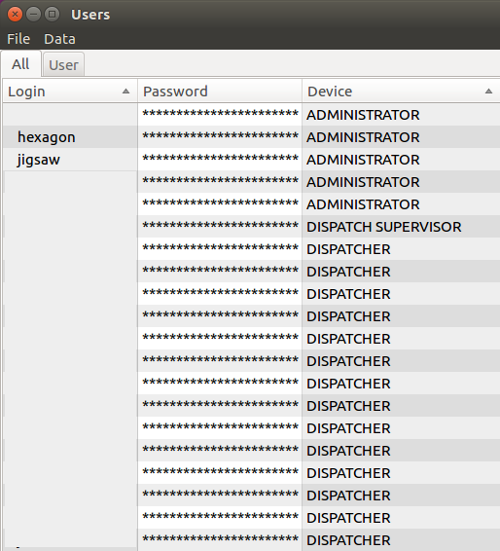
Deployment Project
Users List

Slide 11
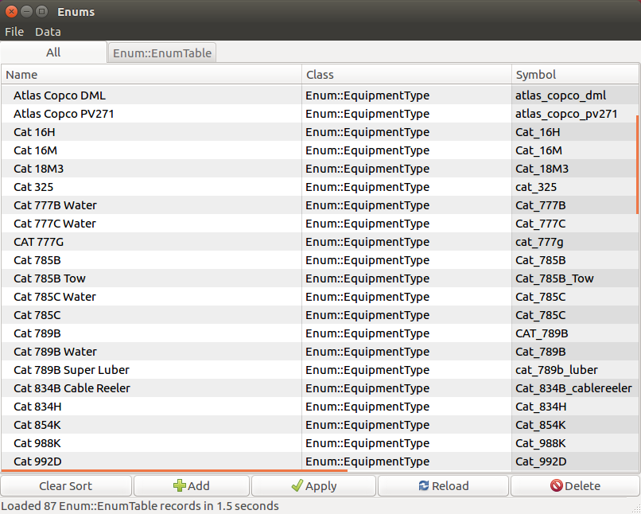
Deployment Project
Equipment Types

Slide 12
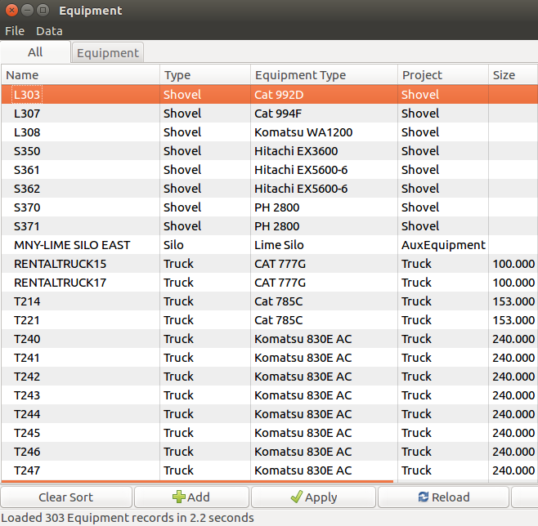
Deployment Project
Equipment List

Slide 13
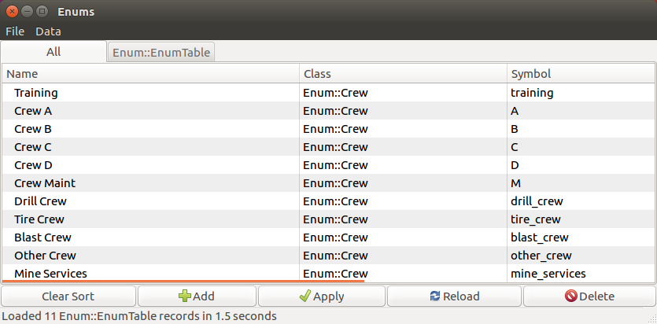
Deployment Project
Crews

Slide 14
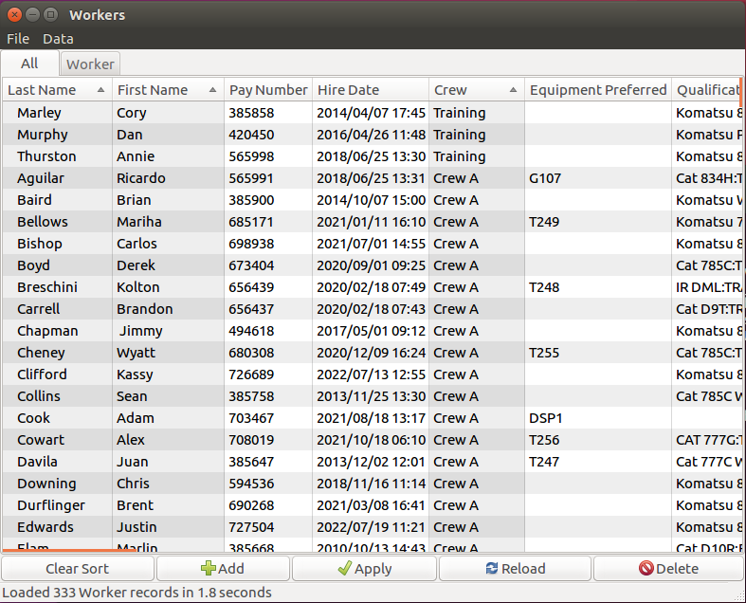
Deployment Project
Workers

Slide 15
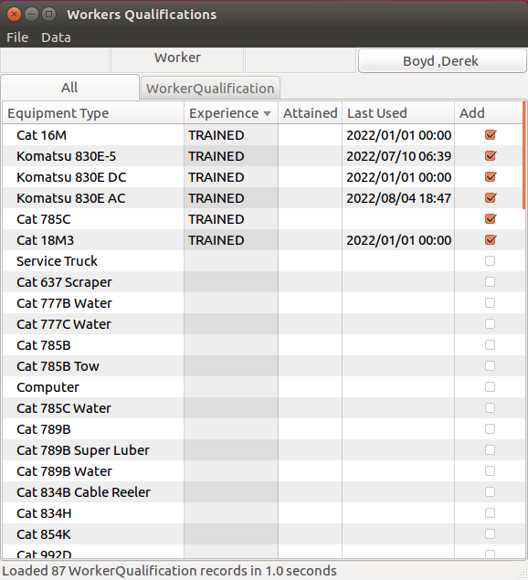
Deployment Project
Worker Qualifications

Slide 16
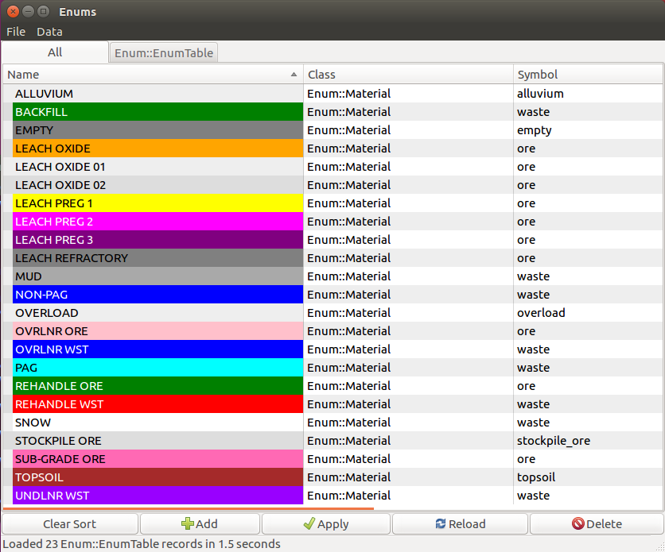
Deployment Project
Materials

Slide 17
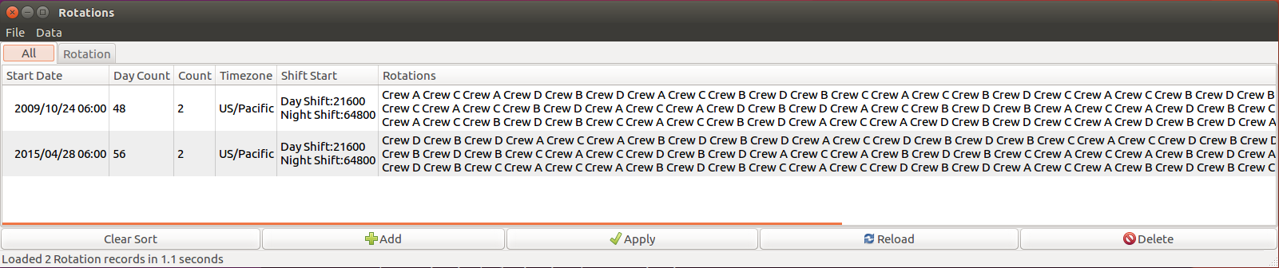
Deployment Project
Rotations

Slide 18
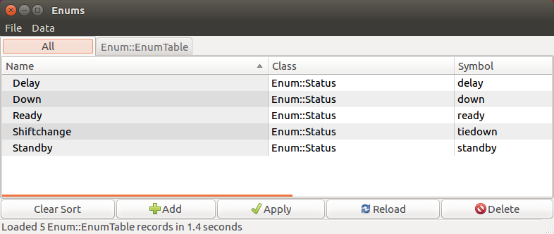
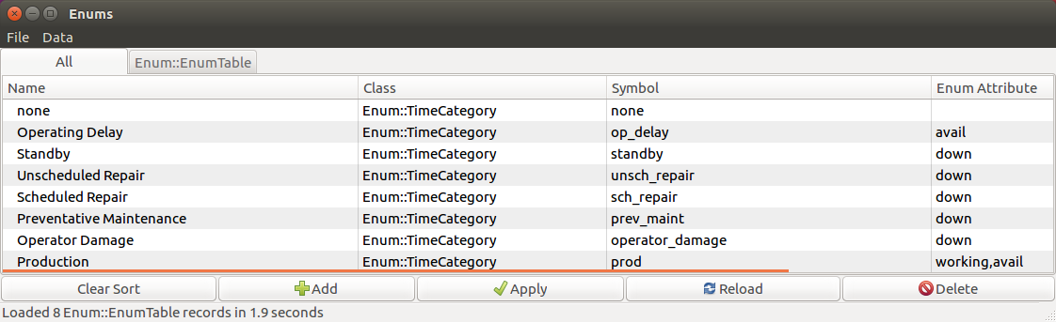
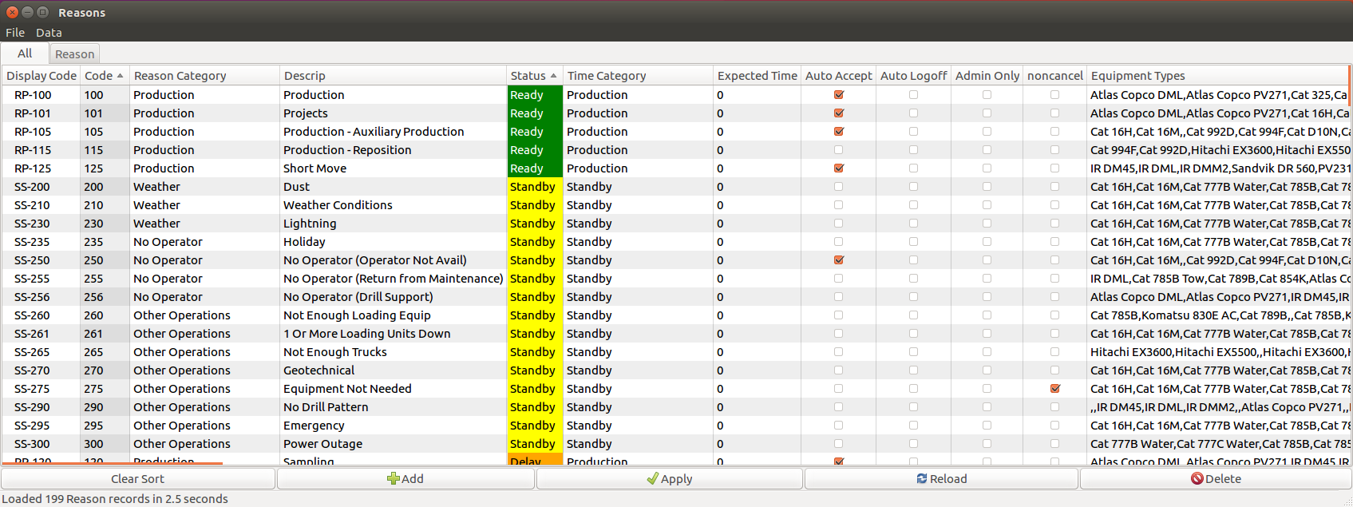
Deployment Project
Statuses and Reasons codes

Slide 19
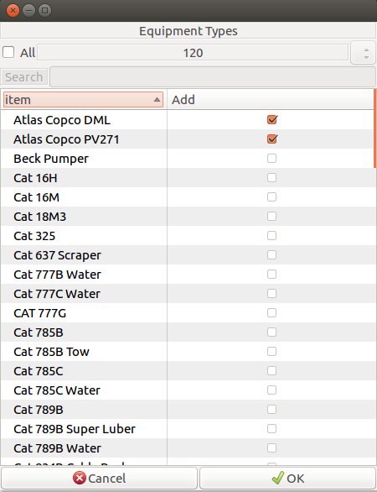
Deployment Project
Reasons by Equipment Type

Slide 20
Deployment Project
Summary Availability and Utilization formulas
Time Model
Total time
Available time |  |  | Down time
Operating time |  | Standby time
Ready time | Delay time

Slide 21
Deployment Project
Summary Availability and Utilization formulas
Available time = Total time – Down time
Operating time = Available time – Standby time
Operating time = Total time – Down time – Standby time
Effective time = Operating time – Delay time
Effective time = Total time – Down time – Standby time – Delay time

Slide 22
Deployment Project
Summary Availability and Utilization formulas
Availability = Available time / Total time
Availability = (Total time – Down time) / Total time
Operational Utilization = Operating time / Total time
Operational Utilization = (Total time – Down time – Standby time) / Total time
Effective Utilization = Effective time / Total time
Effective Utilization = (Total time – Down time – Standby time – Delay time) / Total time
Utilization of Availability = Operating time / Available time
Utilization of Availability = (Total time – Down time – Standby time) / (Total time – Down time)

Slide 23
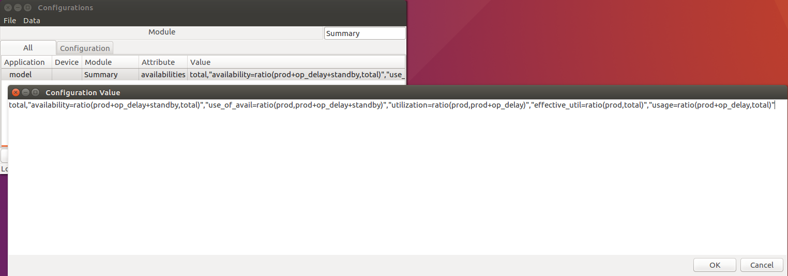
Deployment Project
Summary Availability and Utilization formulas

Slide 24
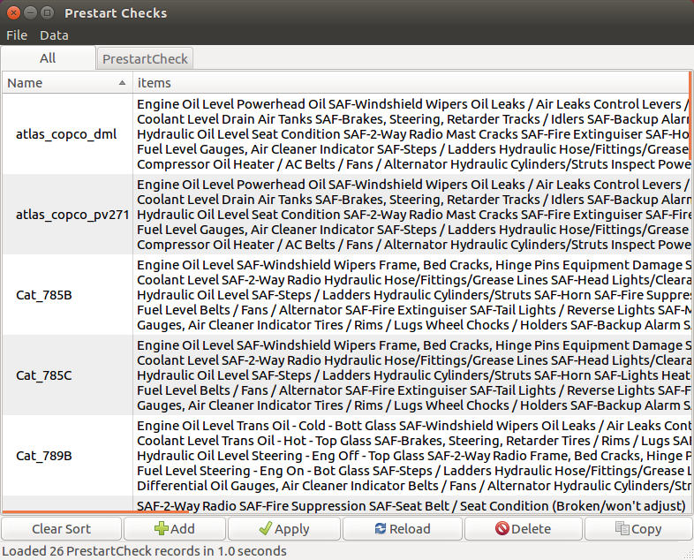
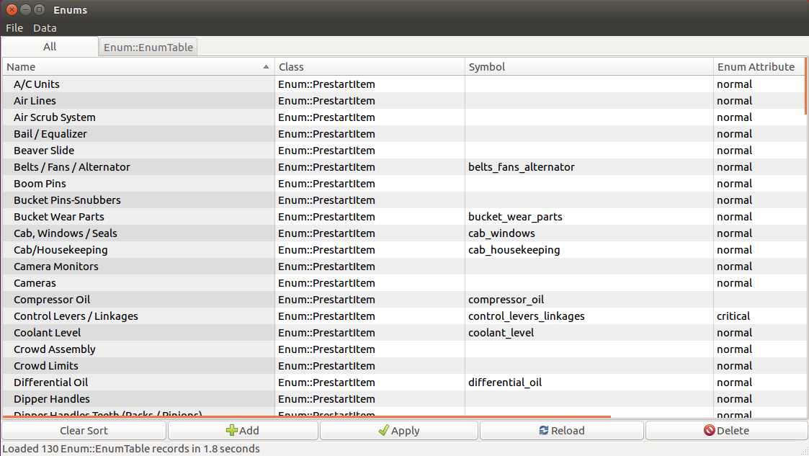
Deployment Project
Prestart items

Slide 25
Deployment Project - Questions

Slide 26
Deployment Project - Answers to Questions

Slide 27

THANK
Y
O
U

